Slide 1

Honda Engineering Collaboration with Local Schools for Technical Staff
February 2020
R. Brown
Building Industry Partnerships that Work
Reddy Brown
Honda
Tad Douce
Tri-Rivers CC

Slide 2
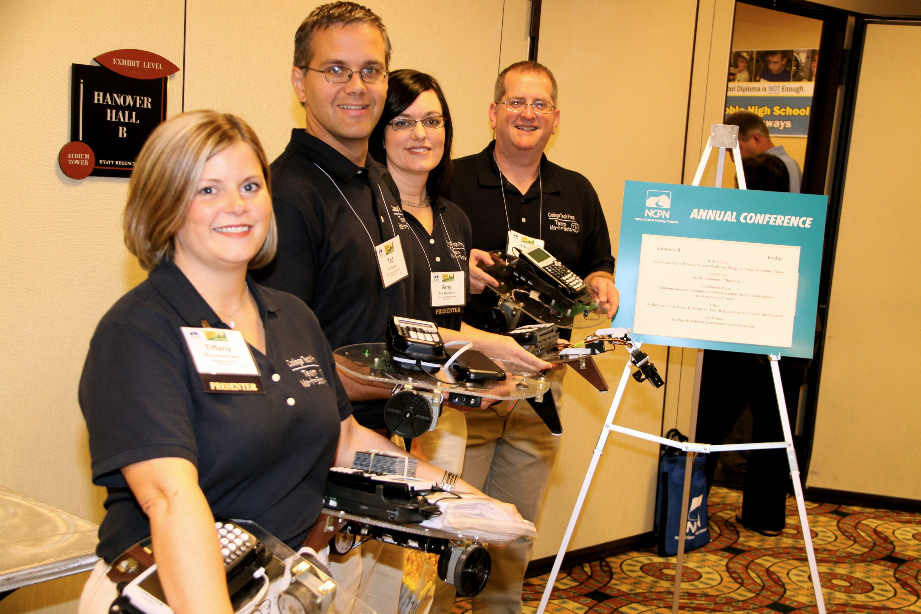
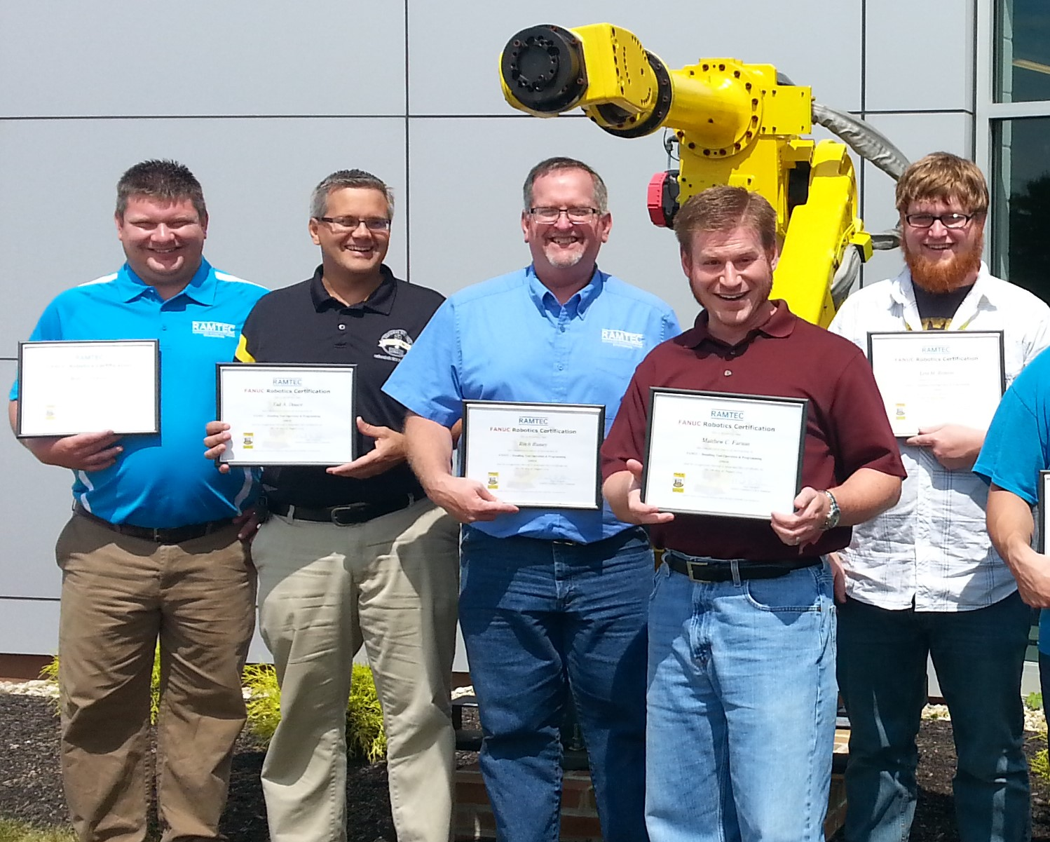
February 2020
R. Brown
Partnerships
Teacher Training
Started in 1997

Slide 3
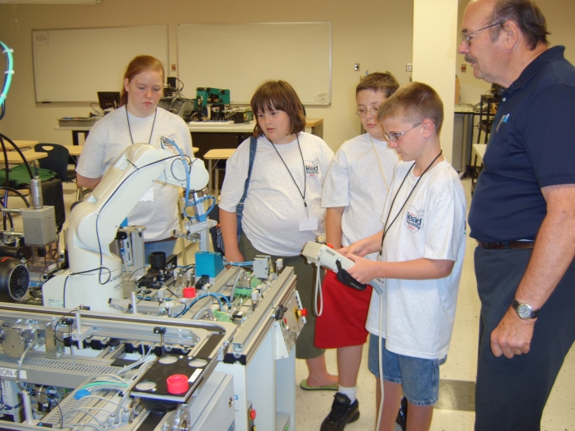
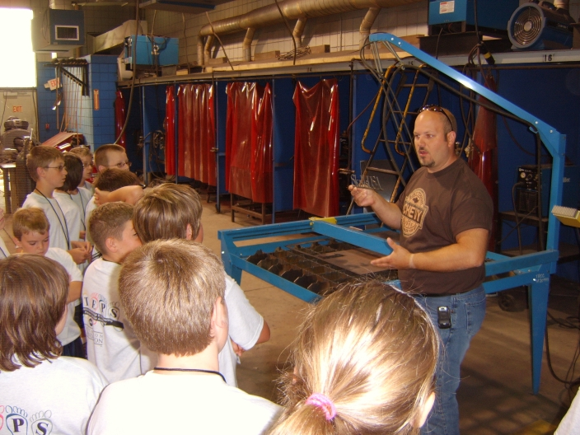
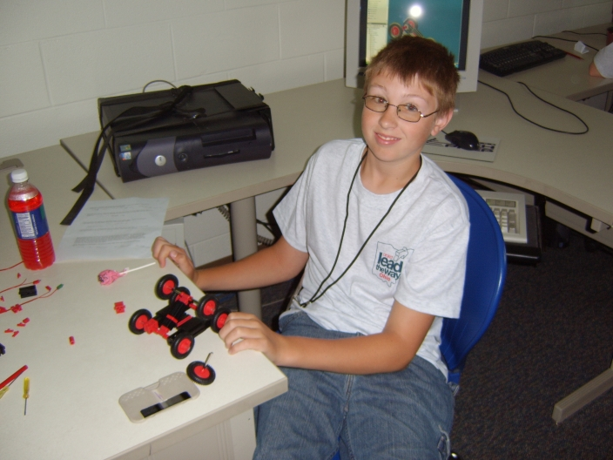
February 2020
R. Brown
Partnerships
Student Camps

Slide 4
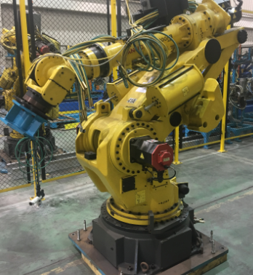
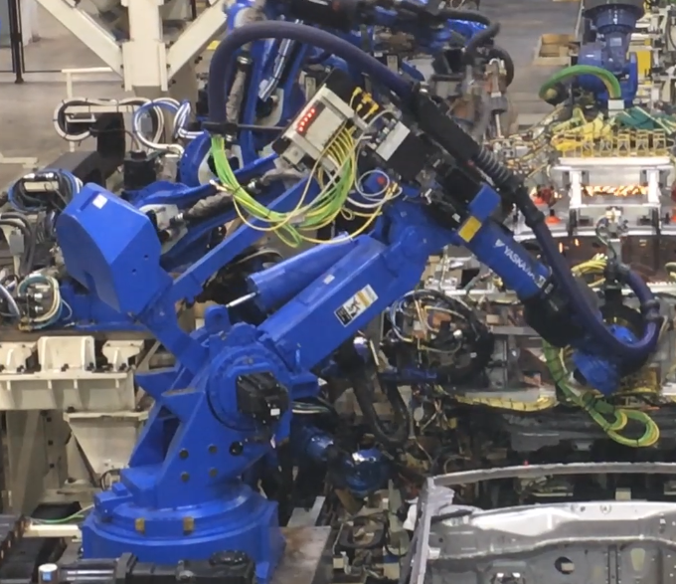
February 2020
R. Brown
Robots controlled by PLC are the main method that automobile manufacturing has automated the car building process. The usage of robots has more that doubled in the last 10 years. The need for technical staff has doubled also. The automation require technical staff to integrate and maintain.
2020
2010
- Welding, handling, adhesives.
- Welding, handling, adhesives, engine install, laser braze, body hemming, body transfers

Slide 5
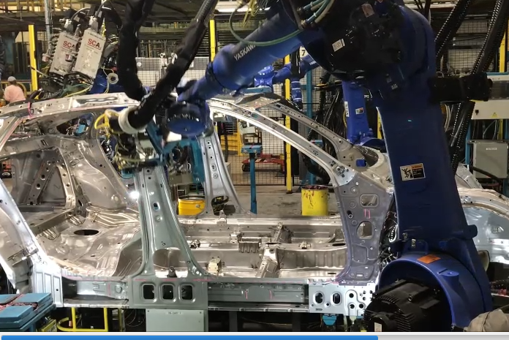
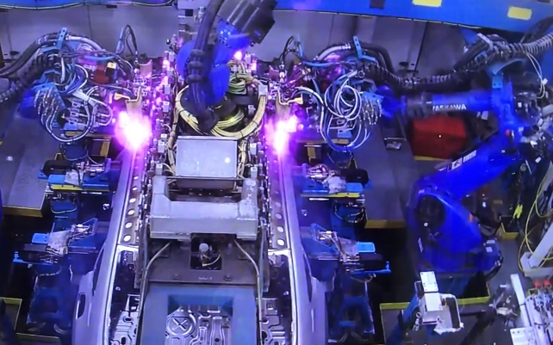
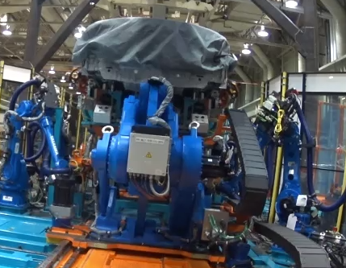
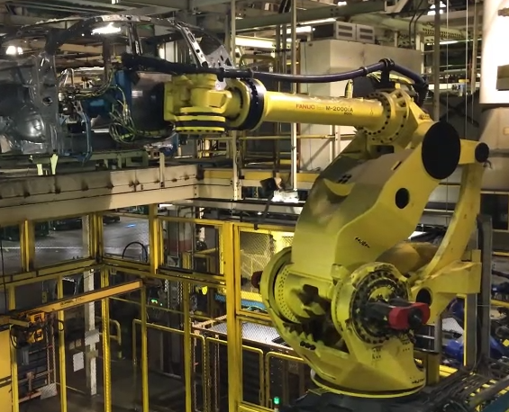
February 2020
R. Brown
Expert staff have been lost due to retirement. Replacement staff have to be able to step in very quickly, with very technical equipment.
Adhesive application
Roof Brazing
Engine / Suspension install
Robot Transfers

Slide 6
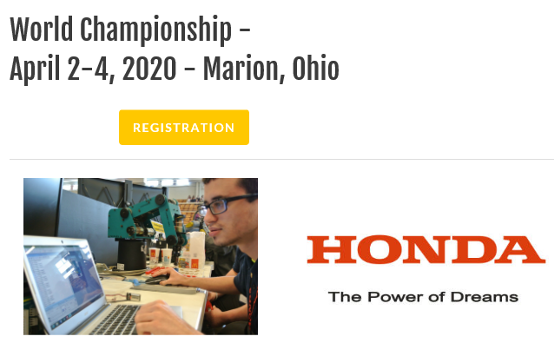
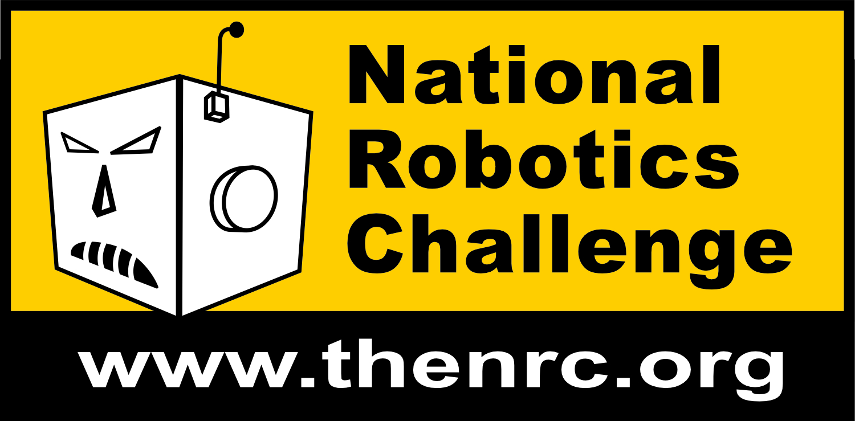
February 2020
R. Brown
The job market is very competitive. It is a market in which it is very hard to find qualified experienced staff that will leave an existing position. Finding talent and training / testing through Co-Op / Intern / Work Study has shown to be a successful strategy. Some ways that Honda EGA has supported the strategy, to encourage technical education:
A. Co-op, work-study programs
Marion Technical College
Columbus State Community College
Edison State Community College
Rhodes State College
C. Local school curriculum board members.
North Union Local School District
Marion Technical College
RAMTEC
B. Shadow programs.
North Union High School (8 years).
Marysville High School (1 time)
Delaware Area Career Center (2 years)
Honda Manufacturing Day (1 year)
Coaching and Judging.
National Robotics Challenge
VEX and FIRST Robotics teams, coaching and judging.

Slide 7
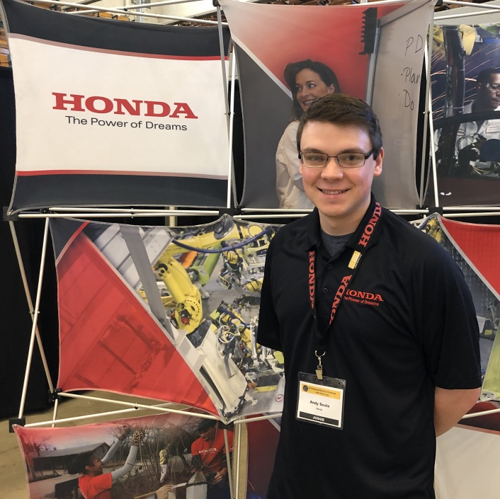
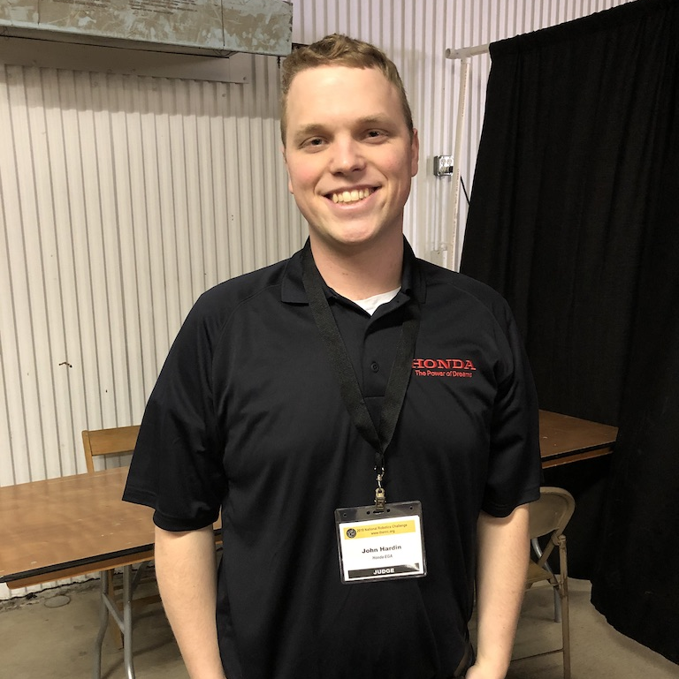
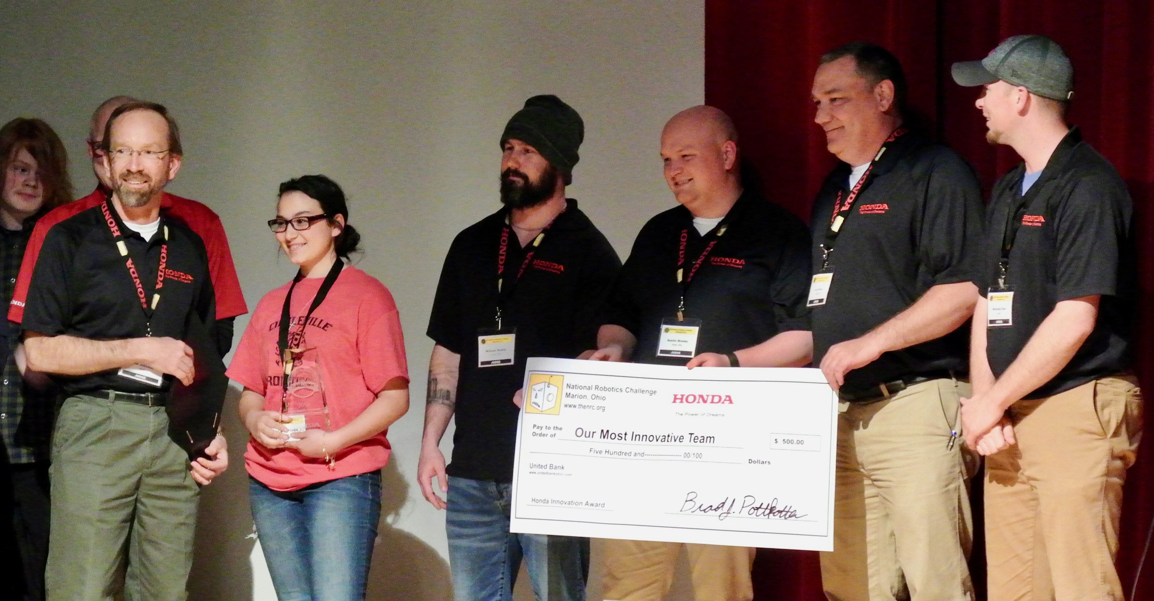
February 2020
R. Brown
Support of Educational Robotics Competitions
Supported the National Robotics Challenge since 2009
Now have team members who started as students in the program.
Students wanted to work for Honda because of their interaction with this event and our associates who judged there
Promoting the skillsets Honda is looking for with the NRC Honda Innovation Award

Slide 8
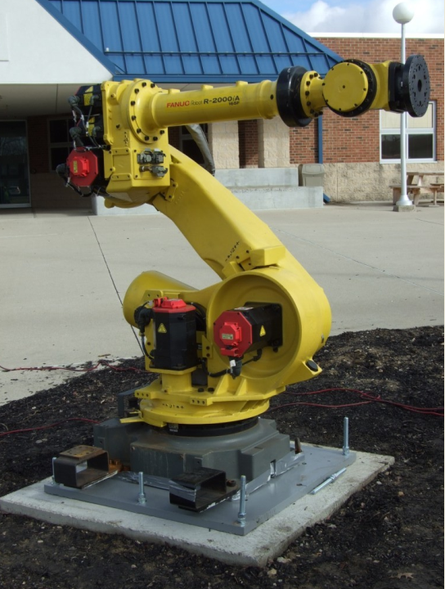
February 2020
R. Brown
Continued improvement. Strengthen partnerships with local High Schools. Support schools to inspire students to find their talent earlier, during High School. The shadow program now allows the students to put hands on, in safe environments. Internships for High Schools students is being studied. The issue of under-age students working in the shop is close to being solved.
To inspire students, Honda EGA supported a local Boy Scout on an Eagle Rank project. This robot statue, using an actual industrial robot, is located at Marysville Early College High School in Marysville Ohio.

Slide 9
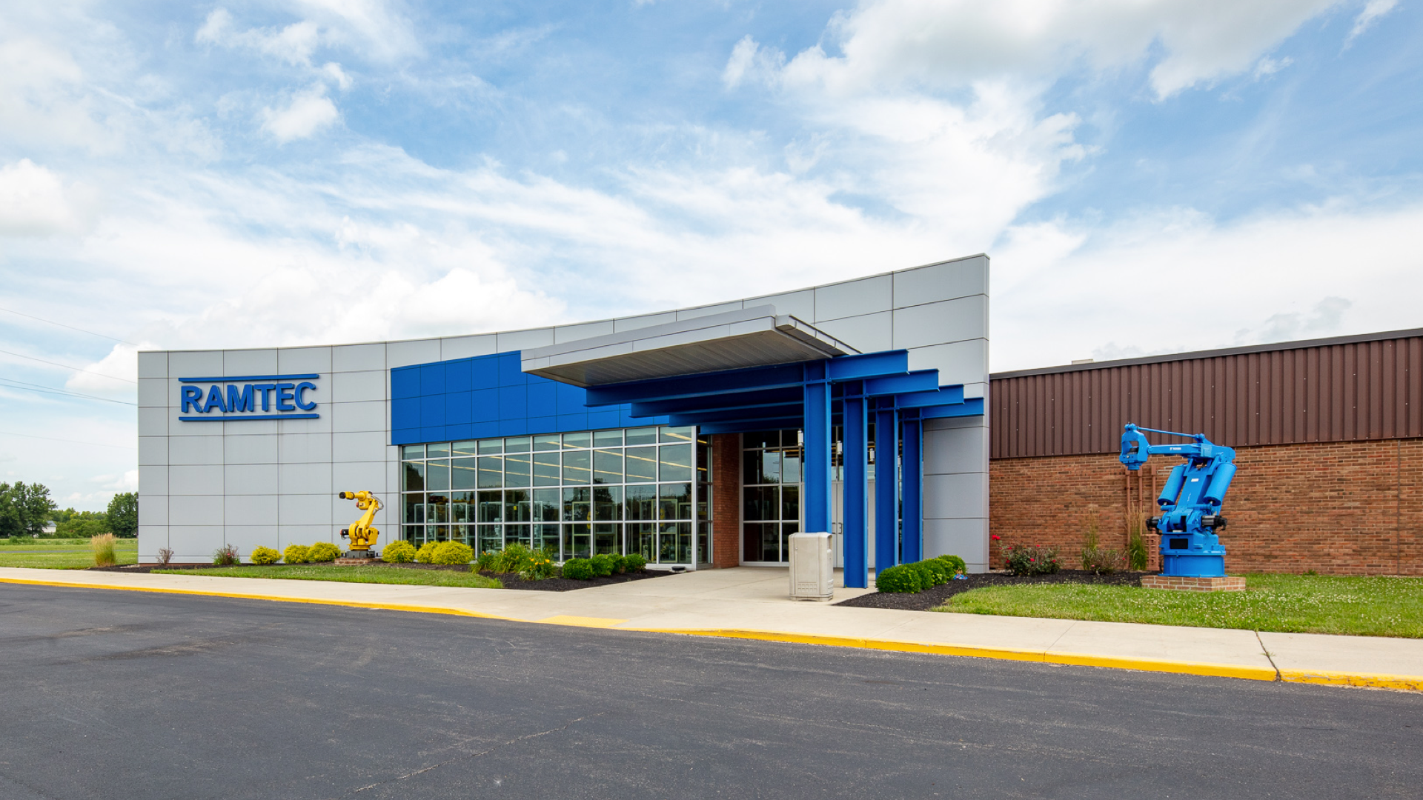
Opened in 2012

Slide 10
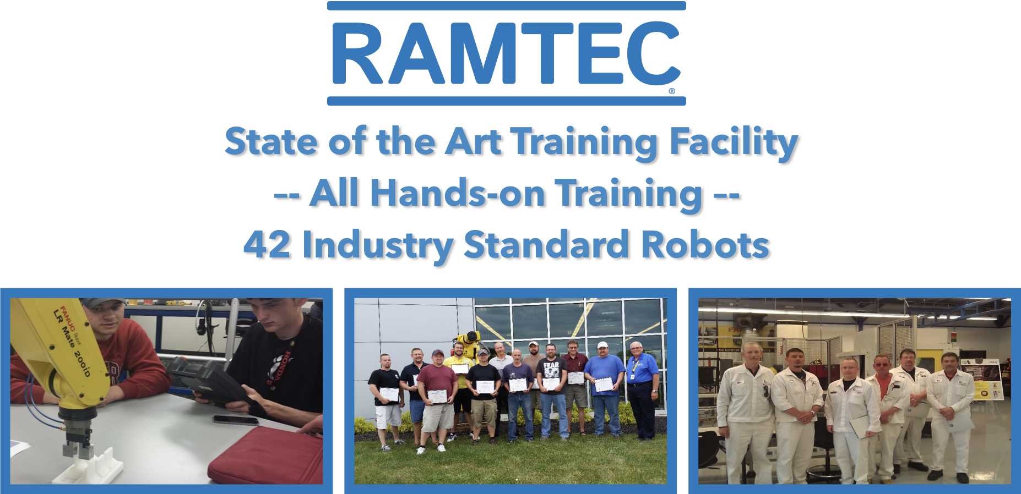

Slide 11
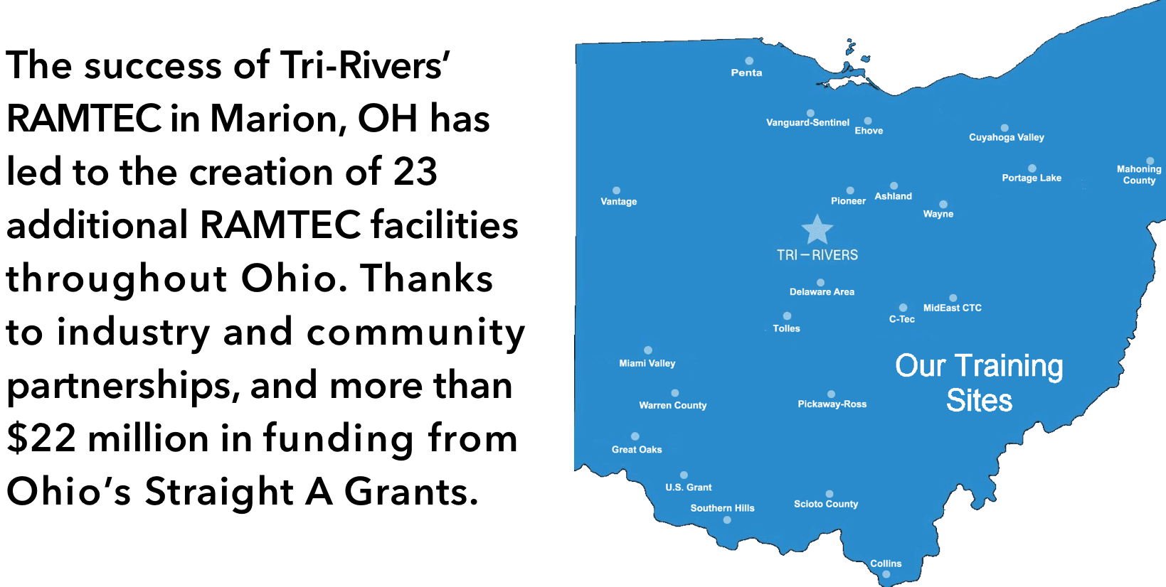

Slide 12
Questions?
Reddy Brown
Honda
reddy_brown@ega.honda.com
Tad Douce
Tri-Rivers CC
tdouce@tririvers.com

